Slide 1

Roxell nipple drinking system

Slide 2
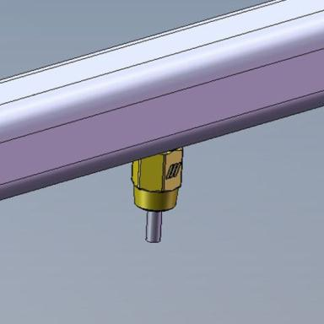
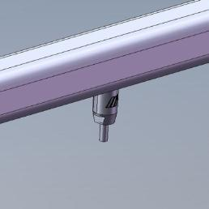
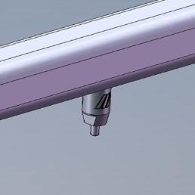
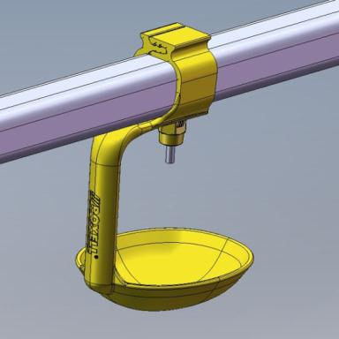
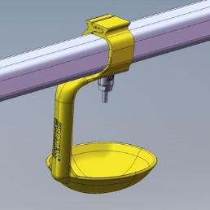
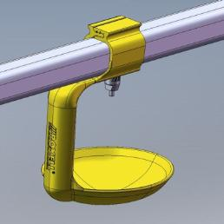
A complete nipple drinker range
Nipples:
  2 activation ways:
  Feather Soft + Vertical
  2 types of housing:
  Metal + Plastic
  2 flow rates:
  130 ml/min + 80 ml/min
Drip cup (big or small)
Plastic nipple
80 ml/min
Metal nipple
80 ml/min
Metal nipple
80 ml/min
Small drip cup
Plastic nipple
130 ml/mini
Small drip cup
Metal nipple
130 ml/mini
Big drip cup
Metal nipple
130 ml/mini

Slide 3
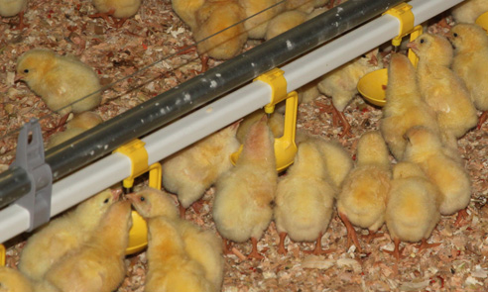
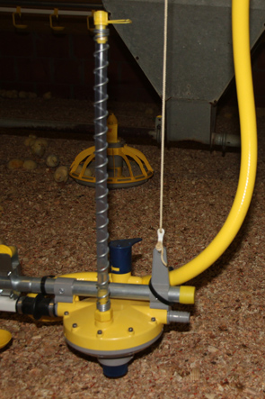
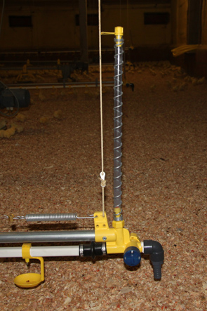
A complete nipple drinker range
Pressure regulator
End unit

Slide 4

A complete nipple drinker range
Flow rate graph
2

Slide 5
A complete nipple drinker range
Flow rate graph
2

Slide 6
A complete nipple drinker range
Flow rate graph
2

Slide 7
A complete nipple drinker range
Flow rate graph
2

Slide 8
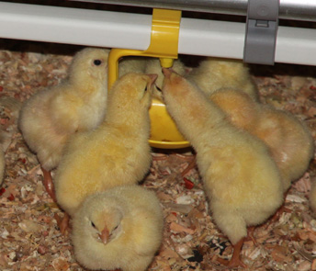
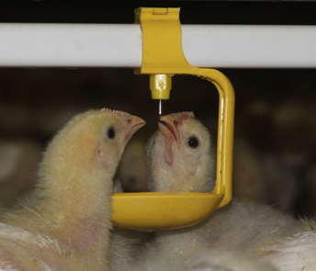
A complete nipple drinker range
Broilers
FS Plastic nipple
130 ml/min
Small drip cup
FS Plastic nipple
80 ml/min
No drip cup

Slide 9
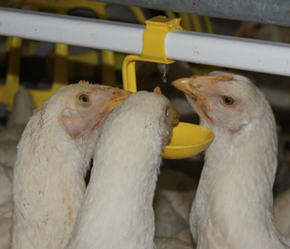
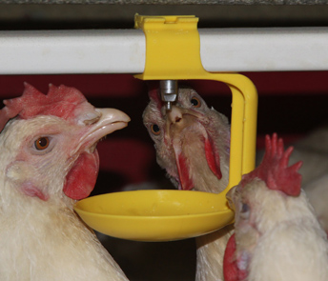
A complete nipple drinker range
Broiler Breeders (rearing (1) – day old to death – production (2))
1
FS Metal nipple
130 ml/min
Small drip cup
FS Metal nipple
80 ml/min
No drip cup
2
VT Metal nipple
130 ml/min
Big drip cup
VT Metal nipple
80 ml/min
No drip cup

Slide 10
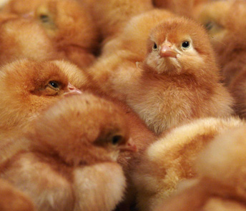
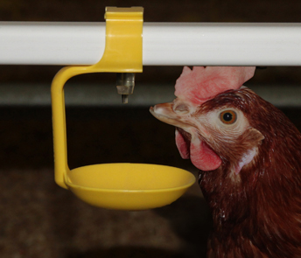
A complete nipple drinker range
Commercial layers (rearing (1) – production (2))
1
FS Metal nipple
130 ml/min
Small drip cup
FS Metal nipple
80 ml/min
No drip cup
2
VT Metal nipple
130 ml/min
Small drip cup
VT Metal nipple
80 ml/min
No drip cup

Slide 11
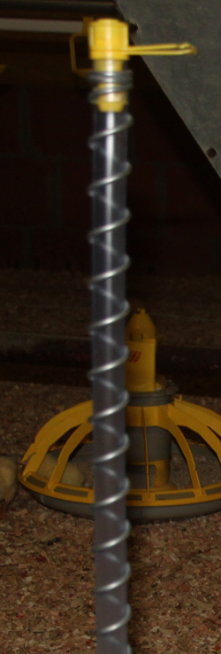
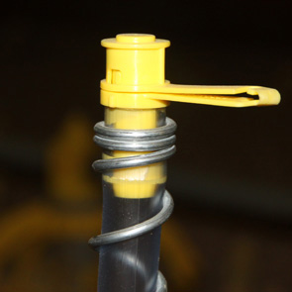
Optimal hygiene
Dry litter and less ammonia
No leaking
  Breather unit:
  Improved sealing (rubber + ball)
  Minimize leaking during flushing
rubber

Slide 12
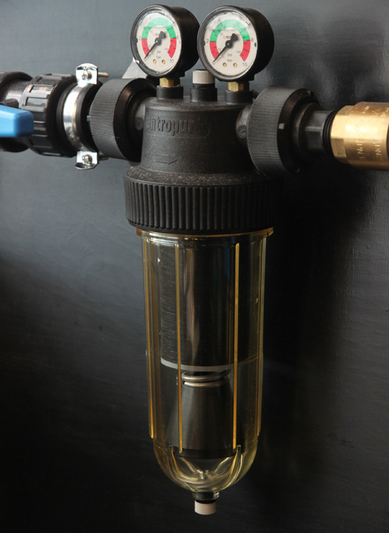
Optimal hygiene
Disc filter on the water panel:
guards the high water quality and prevents the formation of a biofilm
  Opening of 100 micron
  Reusable disc
  Cleaning with high pressure
  Soaking of the discs
Swii’Flo is always protected by using the disc filter

Slide 13
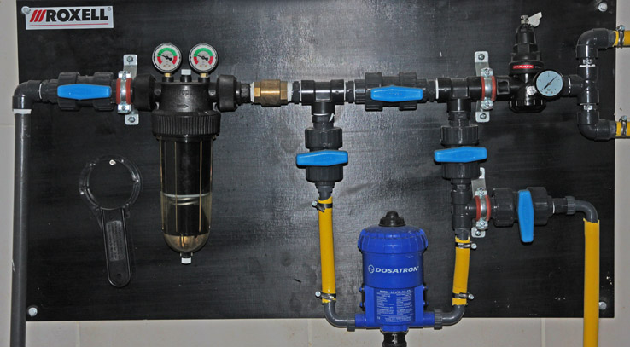
Optimal hygiene
The water panel:
The outlet
  Double check of medicator functioning
  Cleaning the medicator
The restrictor
  Fixed pressure
  No filter inside

Slide 14
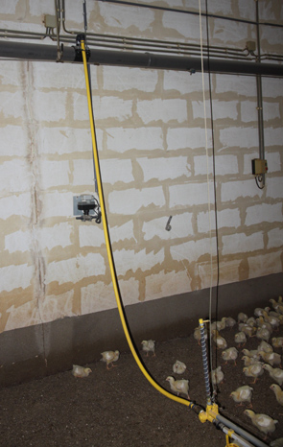
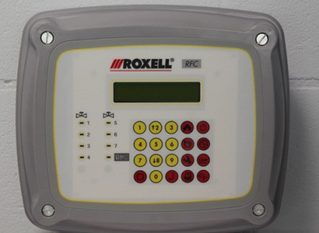
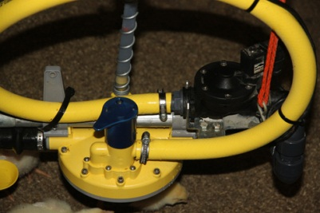
Optimal hygiene
Flushing
Clogging and biofilm:
Reasons:
  Impurities in the water
  Usage of additives
Impact:
  Poor functioning of the
  drinking system
  Poor flock performance
Action:
  Regular and powerful flushing!

Slide 15
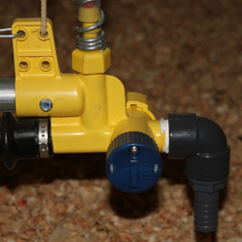
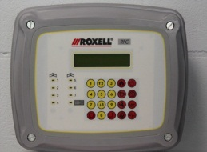
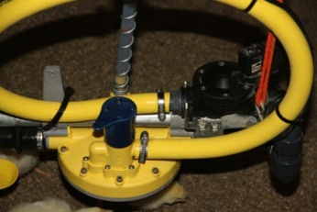
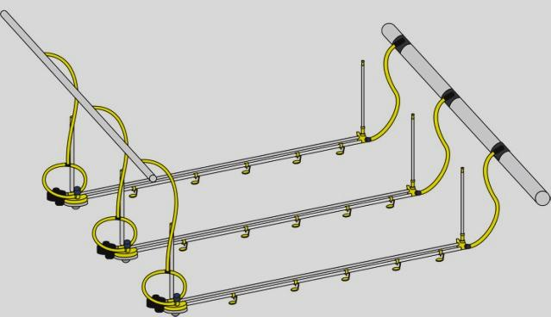
Optimal hygiene
Flushing
3 ways of flushing:
Manual flushing
Flushing with overflow
Flushing with
Roxell Flushing Controller (RFC)

Slide 16
Optimal hygiene
3 ways of flushing
1
1. Manual flushing:
Connect end unit to drain hose (1)
Open end unit valve (1)
Put pressure regulator operational valve
on flushing position (2)
Flush the lines
Put the pressure regulator operation
valve back on open position (2)
Close the end unit valve (1)
1
2

Slide 17
Optimal hygiene
3 ways of flushing
1
2. Flushing with overflow:
Drain hose is connected to overflow (drain tube)
Always the end unit valve in open position (1)
Put the pressure regulator operational valve on flushing position (2)
Flush the lines
Put the pressure regulator operation valve back on open position (2)
2

Slide 18
Optimal hygiene
3 ways of flushing
3. Flushing with RFC:
Flushing valves
Overflow (drain tube) + connections
Temperature sensor/s (optional)
R.F.C
→ perform flushing line after line
→ Max. 7 drinking lines

Slide 19

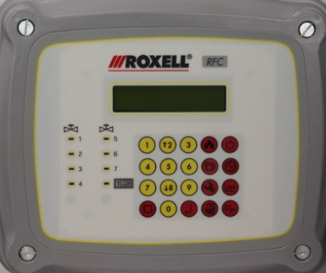



Optimal hygiene
Automatic flushing with RFC
1. Flushing on Time (Table):
Maximum 4 flushing cycles / day
Or flushing during selected days / week
16.00
15.00
14.00
13.00
1
2
3
4
5
6
7

Slide 20
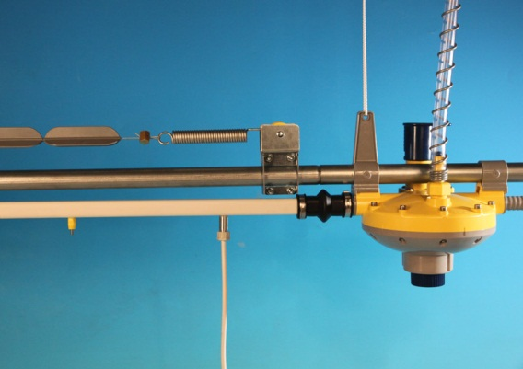
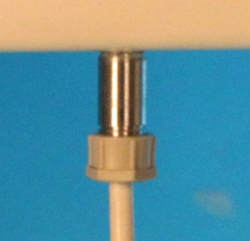


Optimal hygiene
Automatic flushing with RFC
2. Flushing on temperature (water temperature):
With one or two sensors:
  One sensor: Flushing start if water temperature goes higher than a preset value
  Two sensors: Flushing start if difference between the two sensors reached a preset value
Note: minimum time between flushing can
be preset

Slide 21


Optimal hygiene
Automatic flushing with RFC
3. Combination (time table + temperature):
Mainly flushing according to Time - Table
(water temperature is low)
If water temperature goes up
→ flushing start according to temperature
16.00
15.00
14.00
13.00
1
2
3
4
5
6
7

Slide 22


Optimal hygiene
Manual flushing with RFC
1. Flushing on volume*:
What are the advantages?
Flush the line exactly according to line volume
Administrating and distribution of vaccine / medication
Fast, homogeneous and accurate
Less labor
* Each line should be calibrated once.
V1=70L
V2=60L
V3=60L

Slide 23
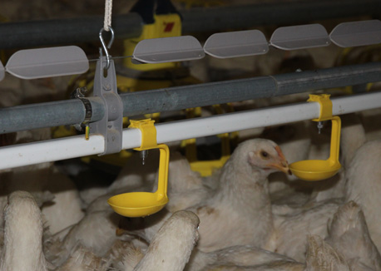
Superior animal welfare
SPINsoft
Non electrical perch protection system
Reduces stress for the birds
No more electrical shocks for the farmer
Retrofit in RNV systems
At beginning some birds try to perch,
but they destabilize
→ SPINsoft is no longer attractive
For optimal functioning:
Line height correct according birds age
Maintain the cable in good tension
Maximum 6 wings between 2 holders
Minimize distance between wing and hanger

Slide 24
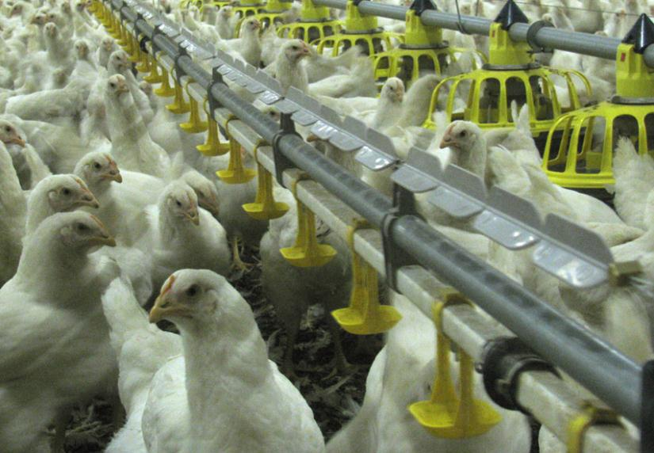
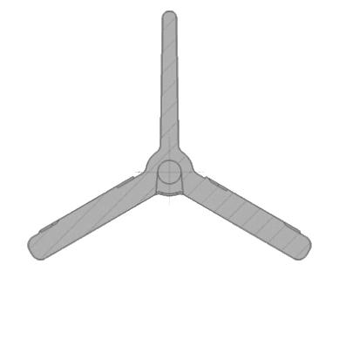
Superior animal welfare
SPINsoft
For better hygiene
2/3 wings heavier
Groove downward
No dirt build up
Better cleaning

Slide 25
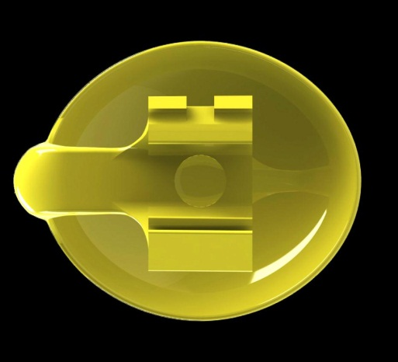
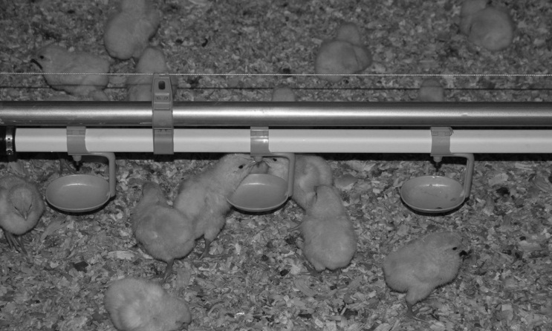
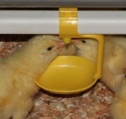
Superior animal welfare
One arm drip cup
More free space around nipple
Same distance around the cup to nipple

Slide 26

Easy maintenance
Pressure regulator
Very strong material
Strong connection between
upper and lower body shell
Thick membrane (1.4 mm)
  → Resists more against cleaning product
  → Handle more flushing cycles ≥ 3 times
Suspended centrally
Support tube not interrupted
  → No pending of the line

Slide 27
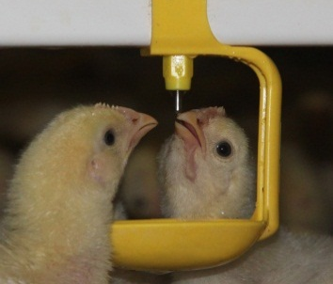
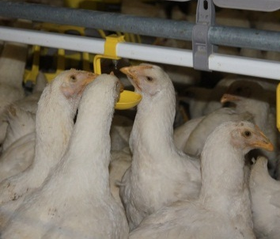
Drinking line height
Adjust drinking line height according to:
Bird size
Bird health
Drinking behavior
Management

Slide 28
Water pressure
To meet the bird’s need of water → water pressure (column) should be adjusted according to:
  Bird age
  Litter quality under the drinking lines
Recommended water column:
Age in days | Water column (cm)
0 – 7 | 2 – 7
7 – 21 | 10 – 15
21 – end of flock | 15 - 30

Slide 29
Vaccination / Medication with RFC
Winch up the drinking lines → birds thirsty (SLIGHTLY)
RFC → fill the drinking lines with the vaccinated / medicated water (exactly → no loss)
Lower the drinking lines to the level of the birds
Fast, accurate and homogenous delivery!
ONE MAN WORK!

